Slide 1
Digital Portfolio
STUDENT NAME :
VISHNU PRIYA. D
24131041802522045 & asanm10424cs31
RIGISTER NO AND NMID:
JAWAHAR SCIENCE COLLEGE
COLLEGE / UNIVERSITY:
STUDENT NAME : MOHAN RAJ .A
REGISTER NO AND NMID :
DEPARTMENT: B.s.c.Computer science
COLLEGE: COLLEGE/ UNIVERSITY: Annamalai University

Slide 2
Simple web Tabulation
Project Name

Slide 3
PROBLAM STSTEMENT:
Web pages created with only HTML appear plain, unstructured, and visually unattractive. Without proper styling, it becomes difficult for users to interpret content, navigate smoothly, or engage with the interface. Static HTML alone cannot handle layout management, responsive design, or visual enhancements across different devices and browsers

Slide 4

AGENDA
Problem Statement
Project Overview
End Users
Tools and Technologies
Portfolio design and Layout
Features and Functionality
Results and Screenshots
Conclusion
Github Link
3/21/2024 Annual Review

Slide 5

PROJECT OVERVIEW:
Cascading Style Sheets (CSS) is a styling language used to control the presentation of web pages. While HTML provides the basic structure of content, CSS defines how that content looks and feels to the user. This project explores the use of CSS to design visually appealing, consistent, and responsive web pages that improve user experience.The project demonstrates how CSS transforms a plain HTML page into a professional, user-friendly interface. By applying modern CSS techniques such as Flexbox, Grid, and custom properties, the project ensures efficient, scalable, and adaptive web design.

Slide 6
WHO ARE THE END USERS?
In software applications, the end users are the people who interact with the software (students using an e-learning app, customers using an online shopping app).In a college admission system, the end users could be students, parents, and admission staff.In business software, employees, managers, or clients could be the end users

Slide 7

TOOLS AND TECHNIQUES:
Tools → Editors, browsers, frameworks, preprocessors.
Techniques → Selectors, box model, flexbox/grid, responsive design, animations, variables

Slide 8
Tools Used:
● Code Editors / IDEsExamples: VS Code, Sublime Text, Atom, BracketsUsed to write and manage CSS efficiently with features like syntax highlighting and auto-completion.
● Web Browsers (with Developer Tools)Examples: Google Chrome DevTools, Firefox Developer Tools, Edge DevToolsAllow real-time editing, debugging, and testing of CSS styles directly on the webpage.
●Preprocessors (Optional)Examples: SASS, LESSExtend CSS with variables, nesting, and functions for better maintainability.
● Version Control ToolsExamples: Git, GitHub

Slide 9
Techniques Used:
Selectors and Specificity → Target elements using tag, class, ID, attribute, and pseudo-classes.
Box Model → Manage spacing with margin, border, padding, and content.
Flexbox and Grid → Create modern, responsive layouts easily.
Responsive Design → Use media queries to adapt layouts across different screen sizes.
Typography Styling → Apply fonts, text alignment, spacing, and transformations.
Colors and Backgrounds → Enhance UI with gradients, images, and transparency.
Transitions and Animations → Add hover effects, fades, and smooth movements.
Pseudo-classes & Pseudo-elements → Style states (:hover, :focus) and add content with ::before / ::after.
Custom Variables (CSS Variables) → Reuse colors, fonts, and themes consistently

Slide 10
POTFOLIO DESIGN AND LAYOUT
Cover PageName, title (e.g., "Student Portfolio" / "Web Developer Portfolio")A professional photo or logo
Introduction / About MeShort bio about who you areCareer goals or personal statement
Table of Contents (optional in digital, useful in printed)
Education / QualificationsAcademic background, certifications
SkillsTechnical skills (coding, design, tools)Soft skills (communication, teamwork, creativity)
Projects / Work SamplesEach project with title, description, tools used, screenshots or linksHighlight your role in the project
Achievements & AwardsAny recognition, competitions, or certificates
Experience (if any)Internships, jobs, volunteer work
Contact InformationEmail, phone, LinkedIn, GitHub, portfolio website
Design & Layout TipsUse consistent fonts and colorsKeep spacing and alignment neatAdd visuals (icons, images, infographics)Prefer a minimalist, professional style

Slide 11
FEATURES AND FUNCTIONALITY
User-friendly Interface – Simple and clean design for easy navigation.Form Validation – Ensures all required details are correctly filled (name, age, documents, etc.).Data Storage – Stores student information securely in a database (if backend is used).Print/Download Option – Allows users to print or save the admission form.Responsive Design – Works well on desktop, tablet, and mobile devices

Slide 12
Functionality:
Students fill out the admission form with personal and academic details.The system validates input (e.g., email format, mandatory fields).Submitted data is saved for further processing by the admission office.Admission staff can review, approve, or reject applications.Users can edit or update details before final submission

Slide 13
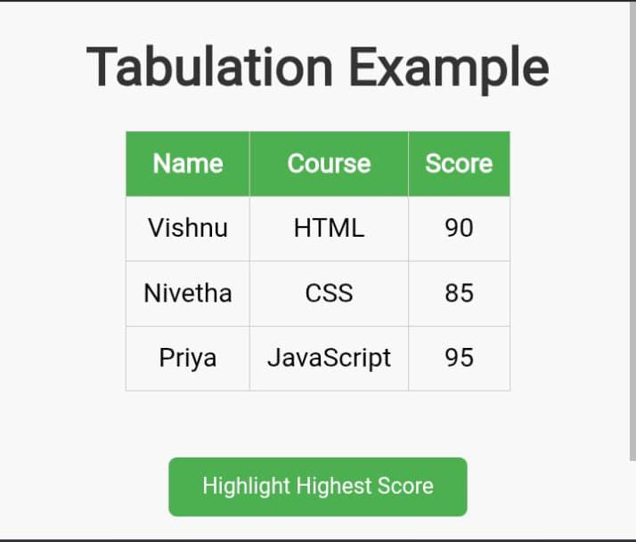

RESULTS AND SCREENSHOTS
3/21/2024 Annual Review
13

Slide 14
CONCLUSION :
The project demonstrates how HTML, CSS, and JavaScript can be effectively used to create an interactive, user-friendly, and efficient system. It simplifies processes, reduces manual effort, and ensures accuracy in data handling. This work highlights the importance of web technologies in solving real-world problems. In the future, it can be further improved by adding database connectivity, automation, and advanced features for better usability
14

